Slide 1
N-Tuple Bandit Evolutionary Algorithm (NTBEA) for Efficient Game Optimisation
Notes:
Evolutionary algorithms are great because they work robustly and can be applied as black-box optimisers. Don’t need gradients and they focus on the bottom line. However, they are not very sample efficient, especially when the objective function is noisy. Emphasise that most people using EAs in game AI are NOT using model based.

Slide 2
Motivation
Emphasize importance of parameter tuning in game AI
And evaluate which methods work best
Best seen as a NOISY optimisation problem
Stochastic games
Stochastic agents
Develop additional games for testing AI agents
Make them efficient to enable rapid experimentation without requiring heavy CPU/GPU resource (more energy-efficient also)

Slide 3
Hyper-Parameter Optimisation: Considerations
Parameter types:
Continuous, discrete, categorical
Flat versus tree structured / conditional
Robustness to Noise levels
From low to high, known versus unknown distributions
Efficiency
Space and time
Depending on number of samples (fitness evaluations), number of parameters / size of search space
Simplicity
Interpretability: how informative is the model?
System being optimised:
Black-box, grey-box, white-box (especially important is parameter sharing)
Is Early Stopping / Anytime possible?
Available software (simplicity of APIs and operability)
Notes:
Probably SKIP this slide

Slide 4
What to optimise: currently discrete search spaces
Each point in the space is specified as an array of int
E.g. {2, 0, 4, 1, 3, 0, 0, 2} What does this mean?
Each integer is an index to an array of parameter values
Currently the value arrays can be of type:
double
boolean
int
This can easily be extended to any other type
The algorithm aims to find good combinations of parameters
And report the statistics of those choices

Slide 5
How this looks in Software
Might seem a bit messy, but it’s all done via interfaces
Key is AnnotatedFitnessLandscape
public interface AnnotatedFitnessSpace extends SolutionEvaluator, AnnotatedSearchSpace { }

Slide 6
SolutionEvaluator
public interface SolutionEvaluator { // call reset before running public void reset(); double evaluate(int[] solution); SearchSpace searchSpace(); int nEvals(); EvolutionLogger logger(); // … }

Slide 7
SearchSpace
public interface SearchSpace { // number of dimensions int nDims(); // number of possile values in the ith dimension int nValues(int i); }

Slide 8
AnnotatedSearchSpace
public interface AnnotatedSearchSpace extends SearchSpace { Param[] getParams(); }

Slide 9
Param
public abstract class Param { String name; public Param setName(String name) { this.name = name; return this; } public String getName() { return name; } public abstract Object getValue(int i); }

Slide 10
N-Tuple Bandit Evolutionary Algorithm (NTBEA)
NTBEA is a new algorithm for noisy parameter optimisation (see our CEC 2017 paper)
The algorithm is efficient, effective and informative
We apply it to tune a rolling horizon evolution agent
And boost performance of this General Game AI algorithm
When properly tuned Rolling Horizon often beats Monte Carlo Tree Search
Using NTBEA we found that long playout lengths in combination with using a shift buffer are key to good performance, also very high mutation rates
Notes:
[45s]

Slide 11
NTBEA involves several concepts: Estimation of Distribution Algorithm (EDA) Evolutionary Algorithm (EA) Combinatorial Multi-Armed Bandit (CMAB)
EDA
CMAB
NTBEA
EA
Notes:
NTBEA is a type of Estimation of Distribution Algorithm, or EDA. This is a kind of Evolutionary Algorithm that uses a model of a population instead of or as well as an actual population. NTBEA still uses a standard EA but does most of the search in the space of a learned model. The model is similar to a combinatorial multi-armed bandit, or CMAB. Here we use it to tune a RHEA, so these are the main concepts involved in this paper. [35s]

Slide 12
Relationship to other models
N-Tuple Bandit EA
Similar to Combinatorial Multi-Arm Bandit (CMAB)
Evolutionary algorithm adds more focused search to bandit sampling process
Bandits: what do they add?
Explicit control of exploitation / exploration dilemma
Natural escape from local optima

Slide 13
NTBEA: block diagram
Note the fat connection between the EA and the landscape model
N-Tuple Bandit Fitness Landscape Model
Noisy Fitness Evaluator
(Algorithm to be tuned)
Evolutionary Algorithm
Notes:
The block diagram shows the main system architecture. It is pretty simple. In the middle we have an almost standard evolutionary algorithm. The noisy fitness evaluator is the system it is trying to optimise - in this case each evaluation involves an agent playing through a stochastic game. On the left we illustrate the EA making many accesses to the bandit landscape model. It uses this surrogate model to improve sample efficiency.

Slide 14
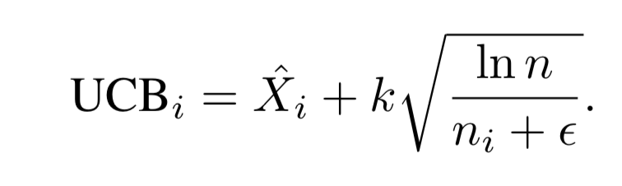
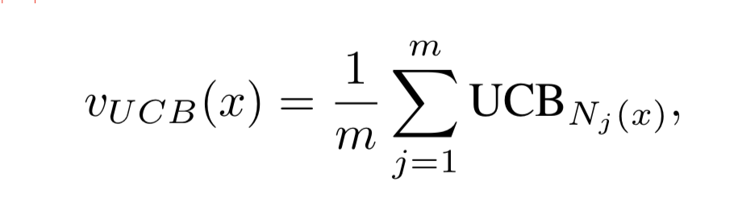
Bandit Equations
Multi-Armed Bandit
Combining Multi-Armed Bandits (simple average)
In this paper m=16
Notes:
Note the use of epsilon which gives a form of progressive widening. Without this would have sample all arms at least once, which could be disastrous for large search spaces.

Slide 15
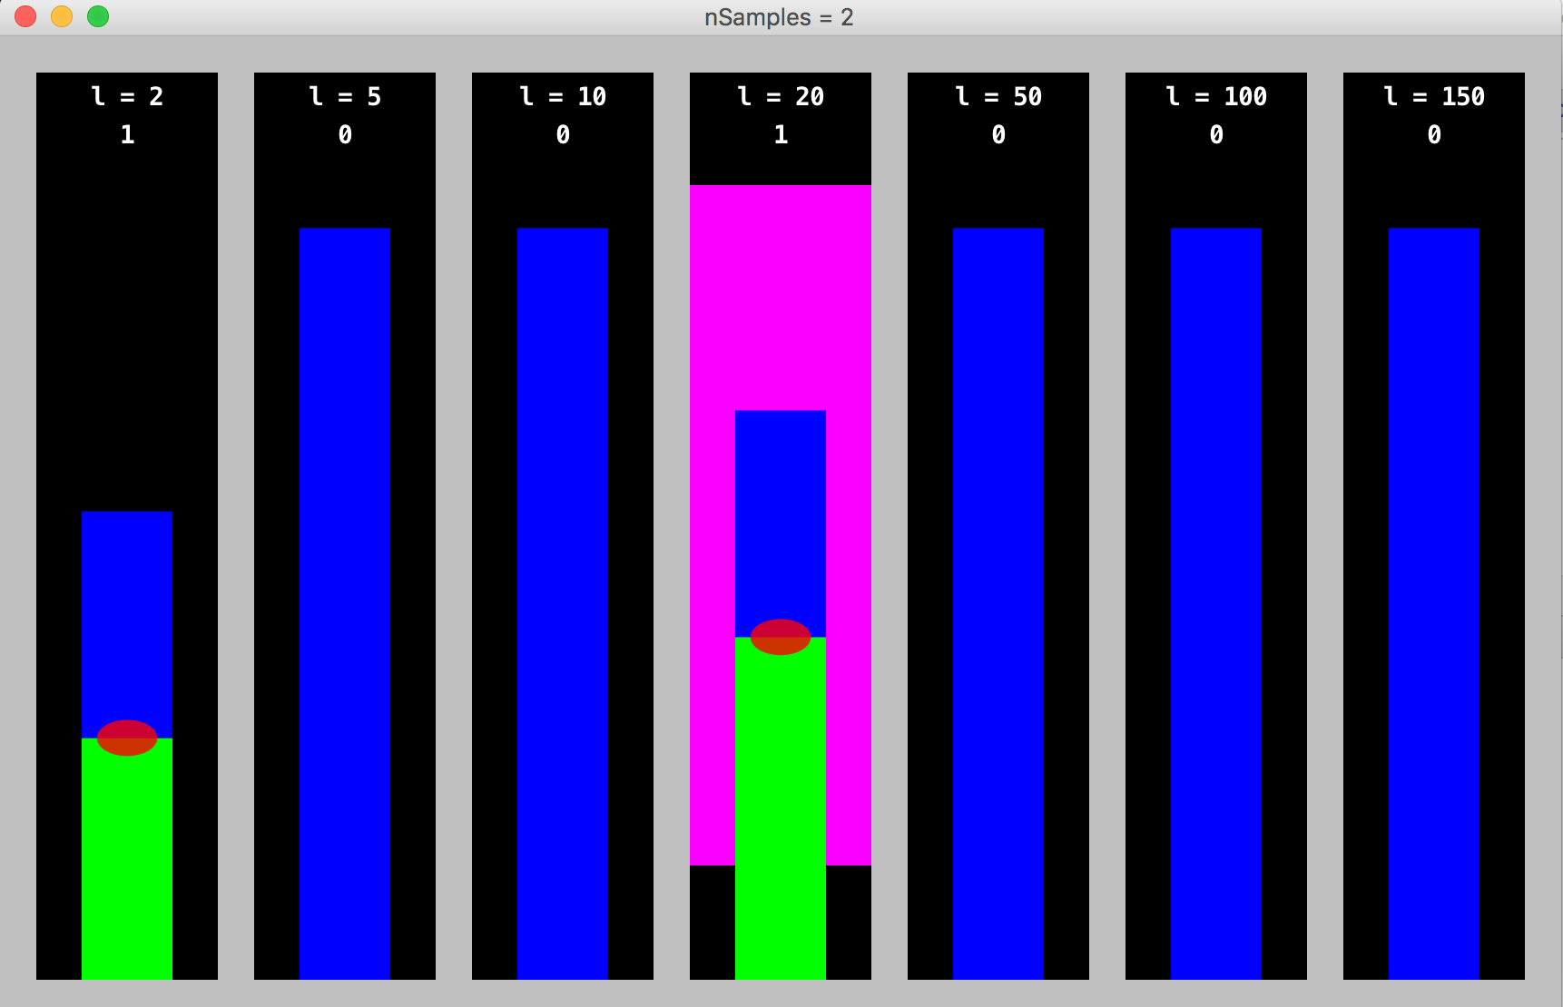
Green bars: exploitation Blue bars: exploration Green + Blue = UCB value
Notes:
l = length parameter

Slide 16
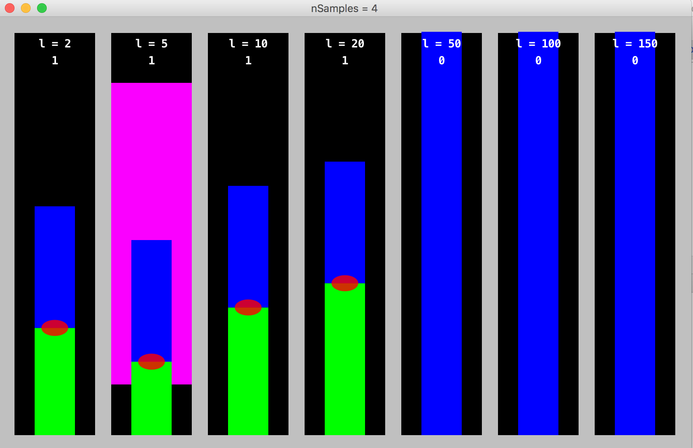
Note how exploration term grows for less sampled options

Slide 17
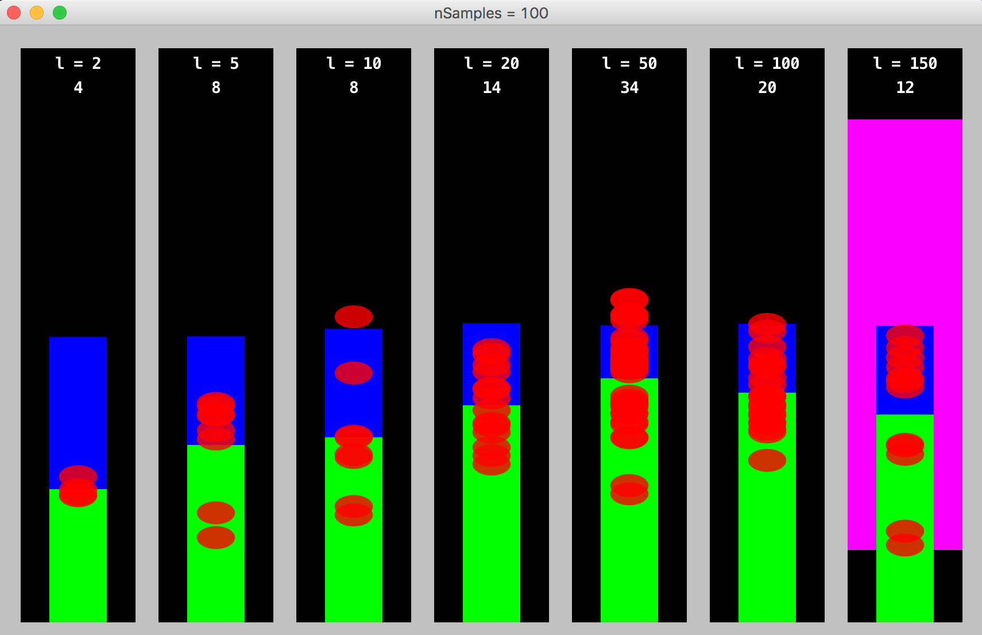
Note how promising options are sampled more frequently

Slide 18
So far, that’s fine for a single parameter
But we need to choose the best COMBINATION of parameters!
Hence the N-Tuple model
Scales well for a large number of parameters

Slide 19
Rolling Horizon Evolution
Evolves sequences of actions/numbers in real-time
E.g.: [left, thrust, shoot, shoot, left, thrust, right, …]
These are interpreted as action sequences and simulated on a copy of the game
Game score may be used as the fitness function
Choose the sequence that leads to the best score, and take the first action
If using a shift buffer, then shift the sequence forward and add a random action to the end to seed the population for the next decision step of the game
Then repeat for each step / turn of the game
Notes:
[45s]

Slide 20
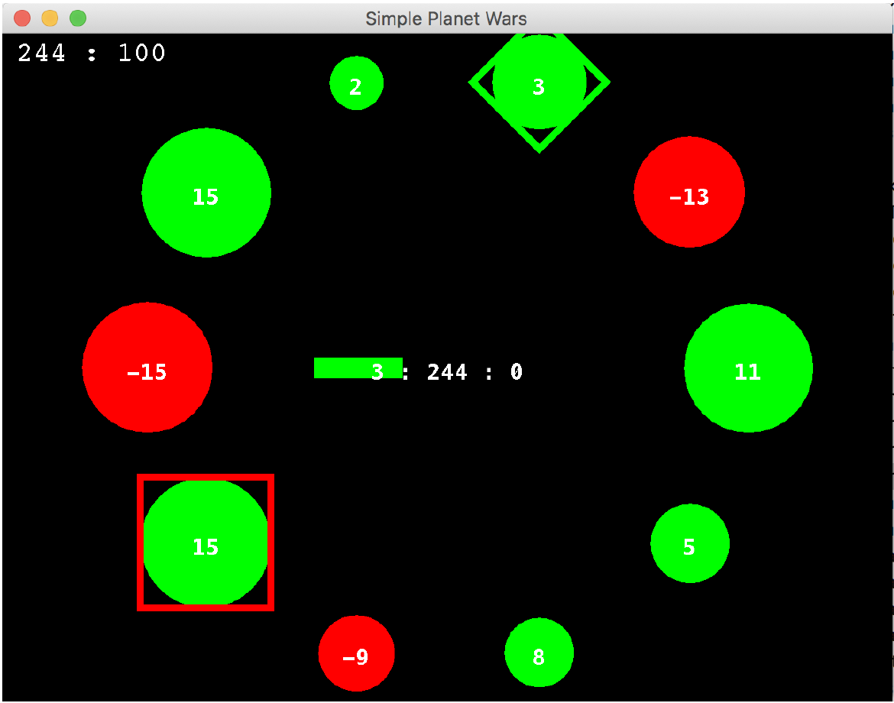
Test Game: Simplified Planet Wars
Random initial states (ownership, planet sizes and number of ships)
Each disc is a planet showing the number of ships and ownership (+ve green)
Planets grow ships are rate proportional to their size
Ships can only be transferred via each player’s buffer and their planet of focus
Aim: wipe out opponent, or have most ships at time limit
Win/loss game (player is only rewarded for winning, margin does not matter)
Constant speed irrespective of number of planets
Notes:
Check out what this means!!!

Slide 21
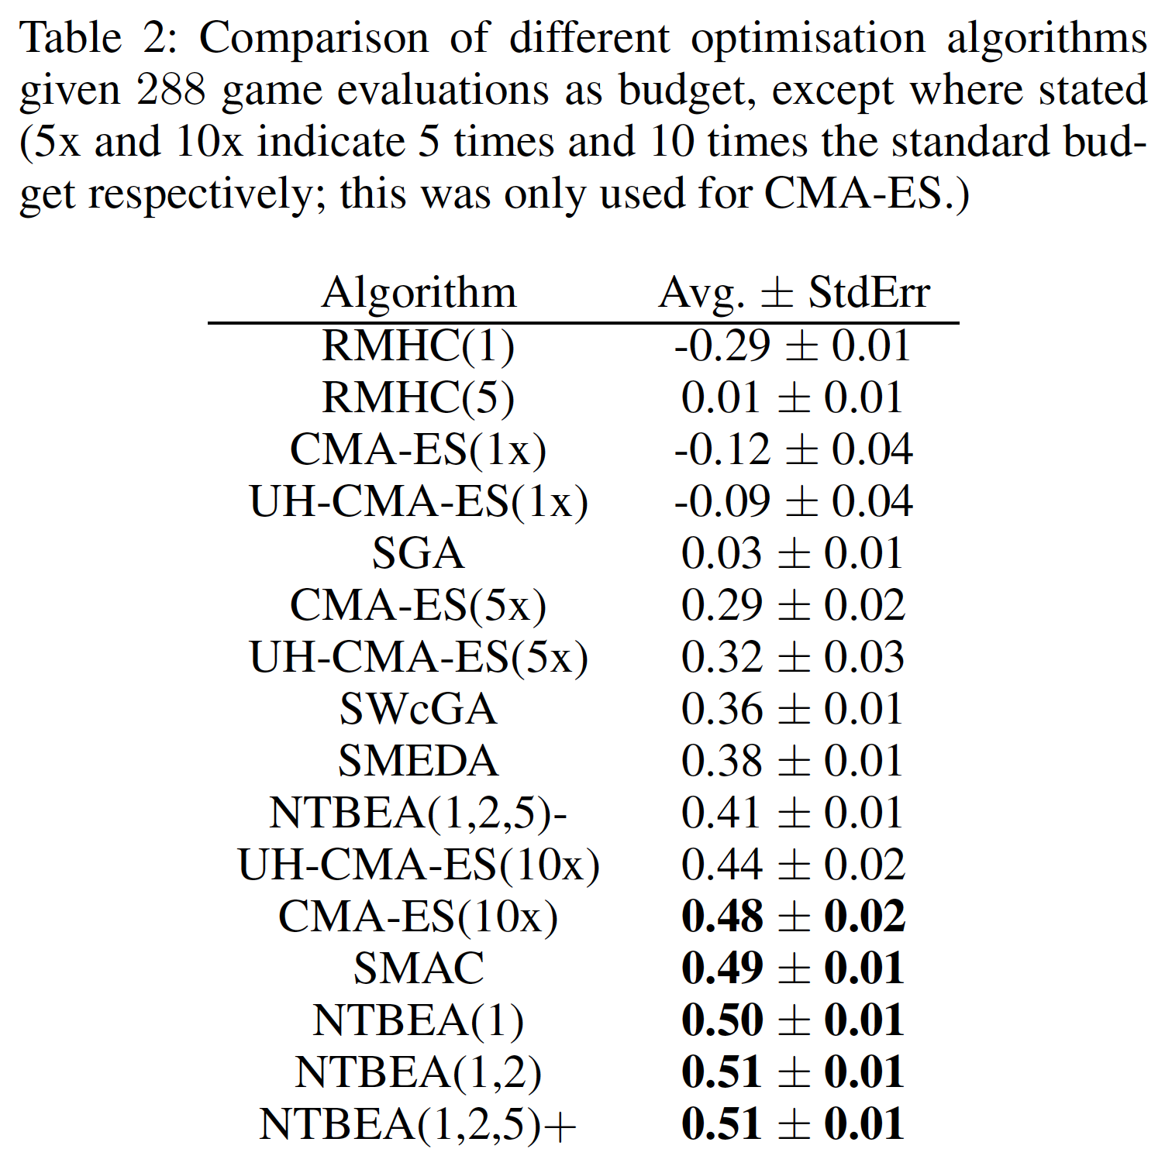
Results
Extremely noisy fitness function
RMHC (1) uses no resampling and is very poor
RMHC (5) resamples but wastes budget
CMA-ES is also poor until we increase its sample budget (hence no longer a fair comparison)
NTBEA and SMAC have the most sophisticated models and perform by far the best
When operating with the small sample budget

Slide 22
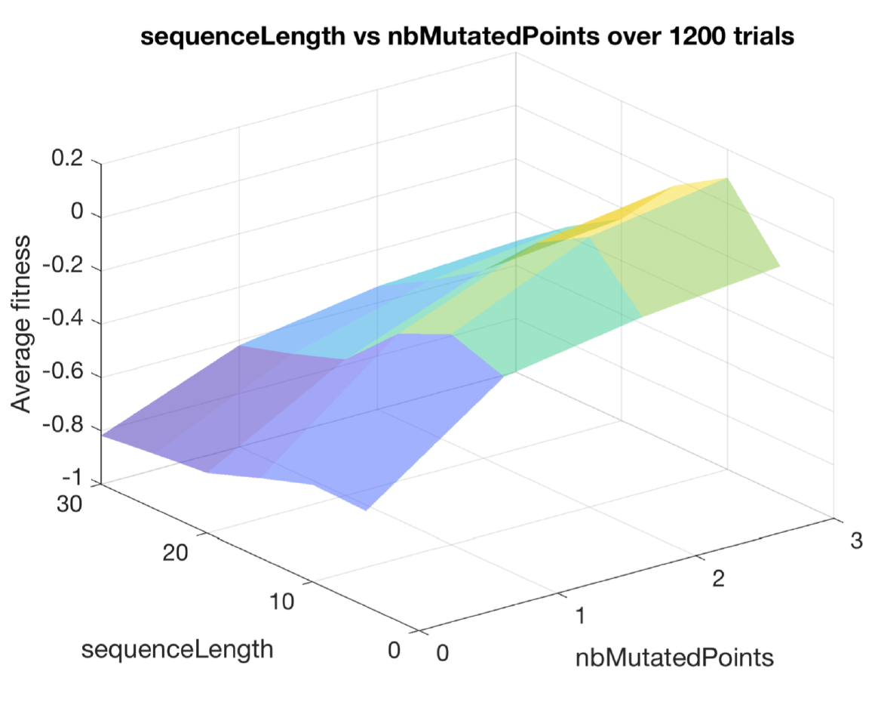
Insight into parameter combinations (Typically 1,2,3 and N-Tuple)
For each combination we also get more complete stats including standard error, min and max

Slide 23
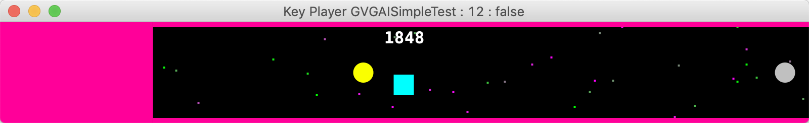
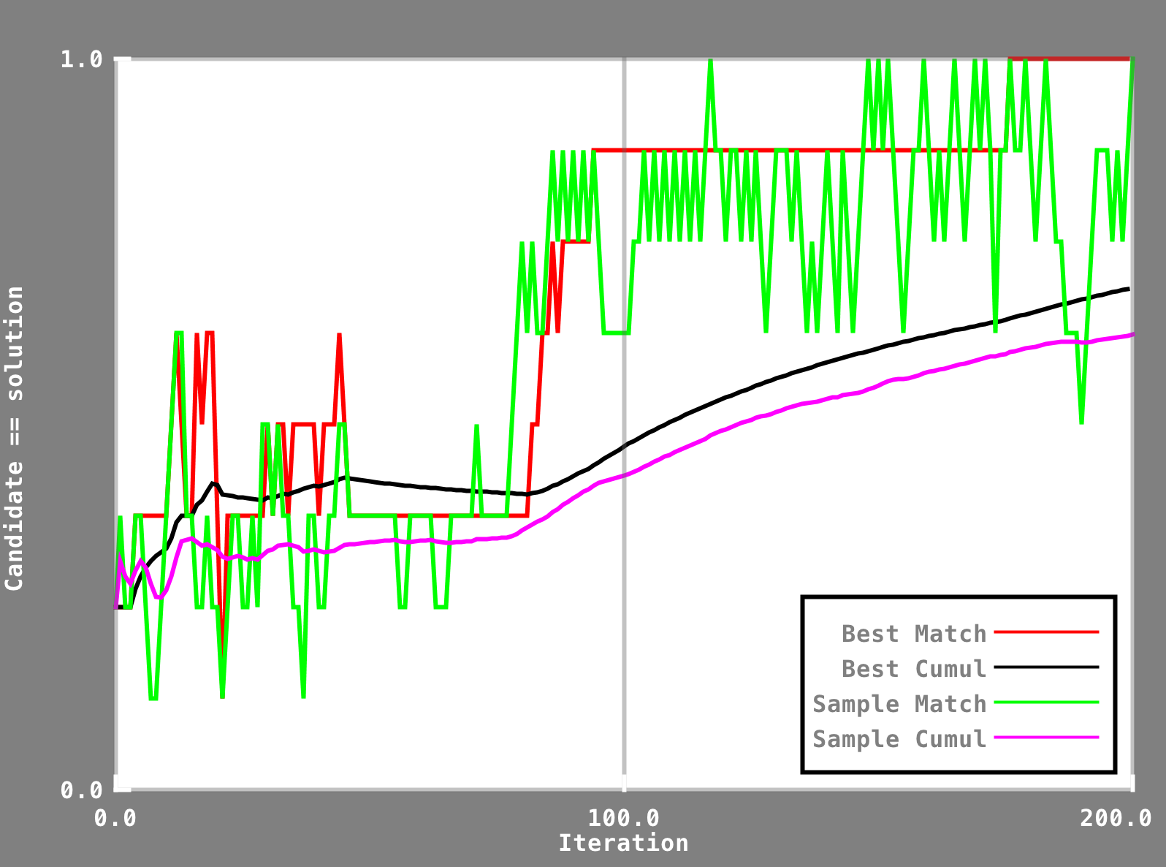
Analysing convergence of NTBEA (8-params)
This plot is from a game parameter optimisation problem (sample budget 200)
It illustrates how the sampling explores options that the algorithm does not consider to be best
And also the anytime nature of the algorithm
Note how the “best” has converged on the final recommendation about 30 iterations in advance
Notes:
This is a problem with 8 parameters (CaveSwing) and makes for a nicer plot than the 5-parameter problem tackled in the paper. Y axis is the fraction of params that are identical to the final solution.

Slide 24
Conclusions
New game with significant skill depth
Evidenced by wide performance variations between the agents
Importance of parameter tuning clearly demonstrated
Well tuned RHEA agents hugely outperformed poorly tuned ones
Tests were run with restricted sample budget (only 288 fitness evaluations per optimisation run)
Model-based clearly performed best
NTBEA is especially simple and informative
We learned that high mutation rates work surprisingly well
Currently only works with discrete / discretized parameters
Future work will add continuous parameters
And also tree-structured parameterisation

